Slide 1
Hunger Action Day 2021: What you need to know to follow our legislature this year
Be part of the democratic process – remotely!

Slide 2
Find your district & your legislators
Find your legislative district & legislators: https://app.leg.wa.gov/DistrictFinder/
Contact info for legislators (and their aides!) – by district, by committee:
https://leg.wa.gov/LIC/Pages/Rosters.aspx
Remember, committee members have expertise & passion for their issues – even if they aren’t your legislators.

Slide 3
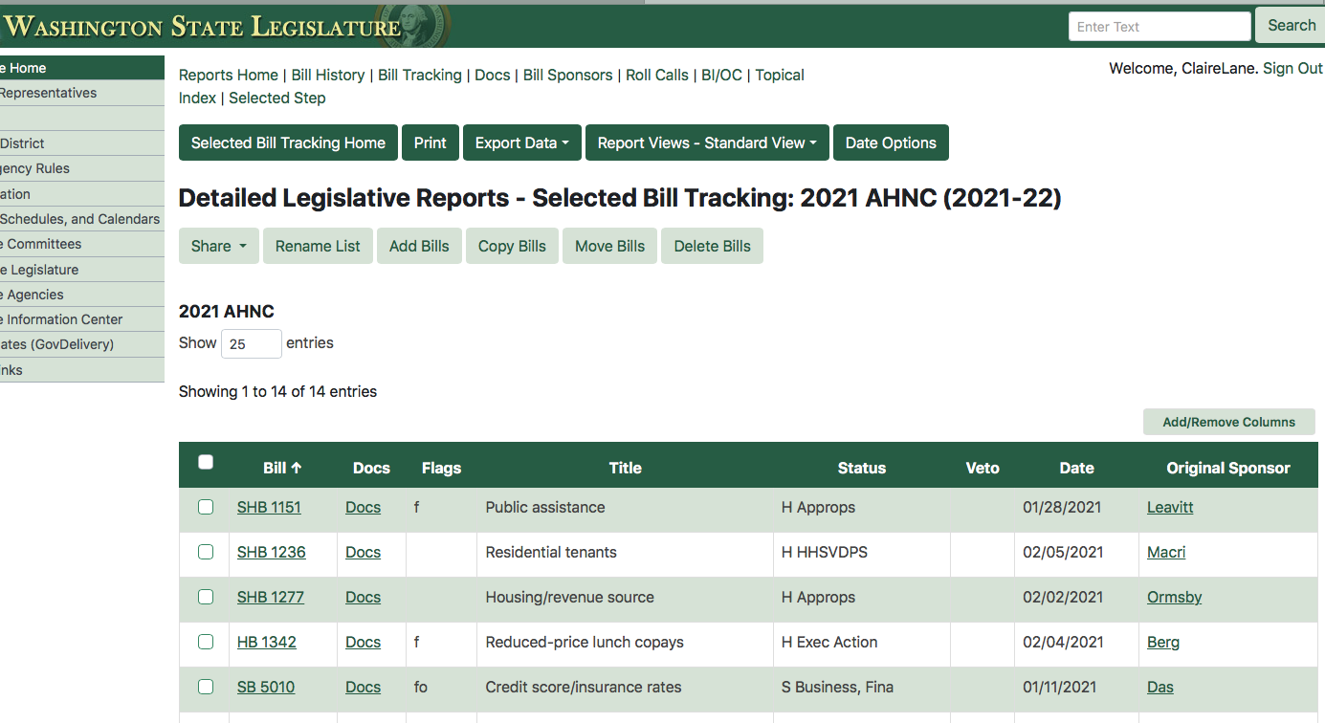
Track your priorities:
Make sure you’re getting action alerts from AHNC and our partners so you get the latest news.
Then create an account with the legislature so you can make your own bill tracker & sign up for notifications as your bills progress:

Slide 4
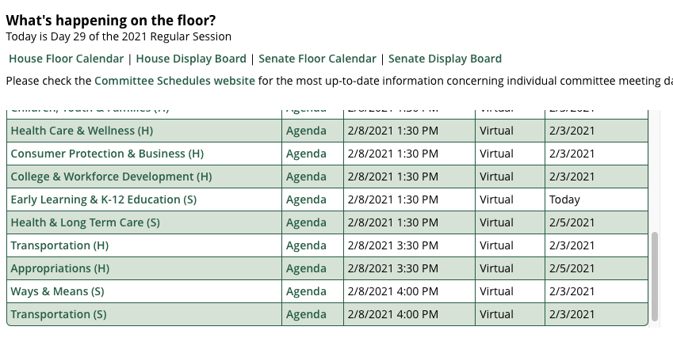
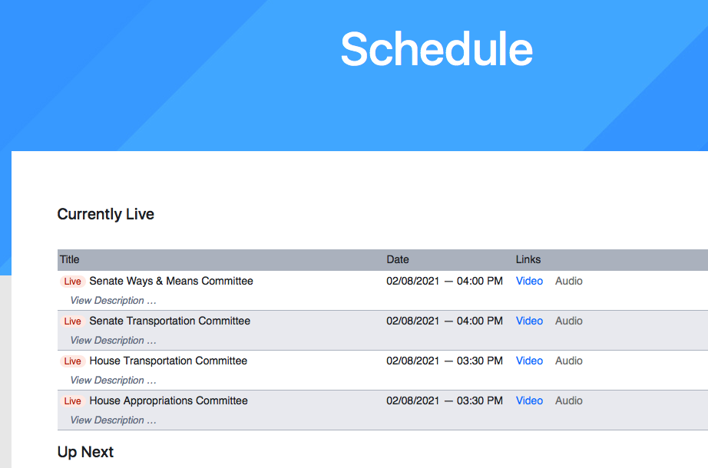
Follow hearings and votes on issues you care about:
Posted on the Legislature’s homepage is a daily schedule of committee meetings - with agendas & bill numbers - as well as floor activity (aka voting)
Then you can watch all hearings and votes on TVW (www.TVW.org) by choosing which committee to watch.

Slide 5
Weighing in on your priorities:
New tools this year to participate:
https://leg.wa.gov/legislature/Pages/Participating.aspx
You or your organization can take positions on bills in 3 different ways: https://app.leg.wa.gov/csiremote
Sign in your position (pro/con/other) within 1 hour before hearing begins
Submit written testimony within 24 hours after hearing begins – sent to all committee members and included as part of the public record on a bill.
Give live testimony – reach out to me to help coordinate

Slide 6
What to expect meeting with your lawmakers:
Virtual meeting platforms: Zoom & Teams – download or practice with both!
You will get a meeting schedule with links for your virtual meetings on Thursday – keep track of that email!!!
Meetings with legislators have always been 15 mins. long – this year they may be even shorter.
It’s always hard when there are big groups – it’s more difficult virtually, so be mindful of making sure everyone at least gets to say their name & organization.

Slide 7
2021 Legislative Priorities: Support Food Banks ($23.1 million)
Expand funding for Emergency Food Assistance Program (EFAP), our state’s core support for local food banks who have had record increases (30% - 300%) in demand for services. EFAP provides flexible funds for local food bank coalitions to address local community needs.
Expand WSDA’s Farm to Food Pantry Grants, which enable food pantries to buy directly from local producers to feed hungry people.
Create COVID-Response food bank funding for WSDA to provide food and supplies and flexible, responsive funds for food banks to respond to emerging opportunities and targeted community needs.

Slide 8
2021 Legislative Priorities: Strengthen SNAP and School Meals
Continue DOH’s SNAP Fruit and Vegetable Incentive Program which matches funds by SNAP shoppers to purchase produce ($3 million)
Eliminate the Co-pay for Reduced Price School Lunch (HB 1342) Kids do better in school when they don’t have to worry whether they can afford meals. Some families struggle to pay for a child’s reduced- price lunches: $146/year for two children.
Create Farm to School to Families grants through WSDA & OSPI to enable school nutrition programs to buy from local farmers to improve the quality and appeal of school meals ($5 million)

Slide 9
2021 Legislative Priorities: End Hunger by Fighting Poverty
Expand funding for Basic Food Education & Training program so navigators at all community & technical colleges can connect low income students with Basic Food and support services ($6 million)
Strengthen TANF (SB 5214) by easing punitive policies created during the Great Recession and extend time limits for families facing hardship.
Invest in housing and homelessness services with $250 million for permanent affordable housing though the Housing Trust Fund and document recording fees to fund ongoing homelessness prevention.
Prevent homelessness by protecting tenants by providing rent assistance (HB 1277) and prevent evictions without just cause (HB 1236).

Slide 10
2021 Legislative Priorities: Our Ongoing Commitments
Sustainable Revenue for a Healthy, Hunger-free Washington
Create a more fair and balanced state tax system by closing outdated tax loopholes, increasing transparency in tax breaks, and finding new and sustainable sources of revenue to ensure services are available to help people out of poverty and to invest in the foundations of a healthy, prosperous and hunger-free Washington.
Protect Investments in Nutrition, Health & Economic Stability for People in Need
Our state has created innovative programs and proactive policies that help fight hunger and poverty in our communities. Our Coalition is committed to protect and strengthen basic needs, anti-hunger, and anti-poverty programs for low-income people so these programs continue to fight hunger and build stable pathways out of poverty.

